Slide 1
MIS 321
Interfaces

Slide 2
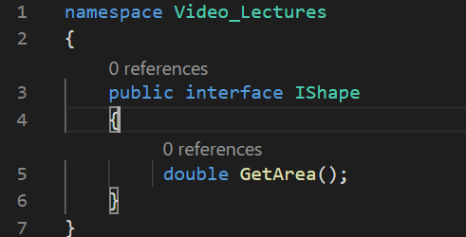
What is an Interface
Similar to a class in terms of syntax, but are fundamentally different.

Slide 3

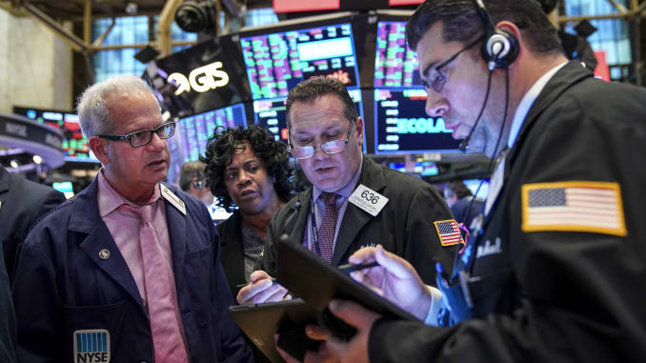
Why use an Interface
To build loosely coupled code.

Slide 4
Tightly Coupled
StockBrocker
Purchaser
StockBroker has a Purchaser object as a field

Slide 5
Loosely Coupled
<<Interface>>
StockBrocker
IPurchaser
StockBrocker has a Purchaser object as a field

Slide 6
Questions?

